Slide 1
LUUSWP 2024/2025
UNIVERSITY OF LEEDS SWIMMING AND WATER POLO
Sponsorship Brochure

Slide 2
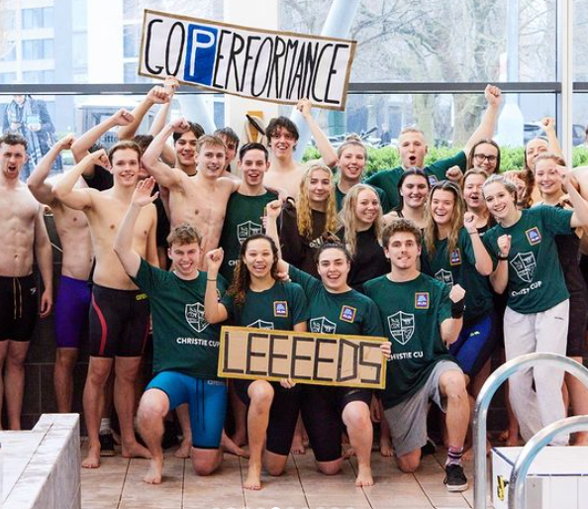
Table of Contents
Executive Summary
Club Overview and Our Goals
Our Achievements
How will your Sponsorship help you?
How will your Sponsorship help us?
Sponsorship Packages
Contacts

Slide 3
1. Executive Summary
Leeds University Swimming and Water Polo is one of the largest mixed societies at the University of Leeds. With over 250 members and a friendly yet competitive atmosphere, every year our committee look for new sponsorship.
This brochure details the benefits your company and our members would yield should you be inclined to sponsor us for the academic year of 2024/25.

Slide 4
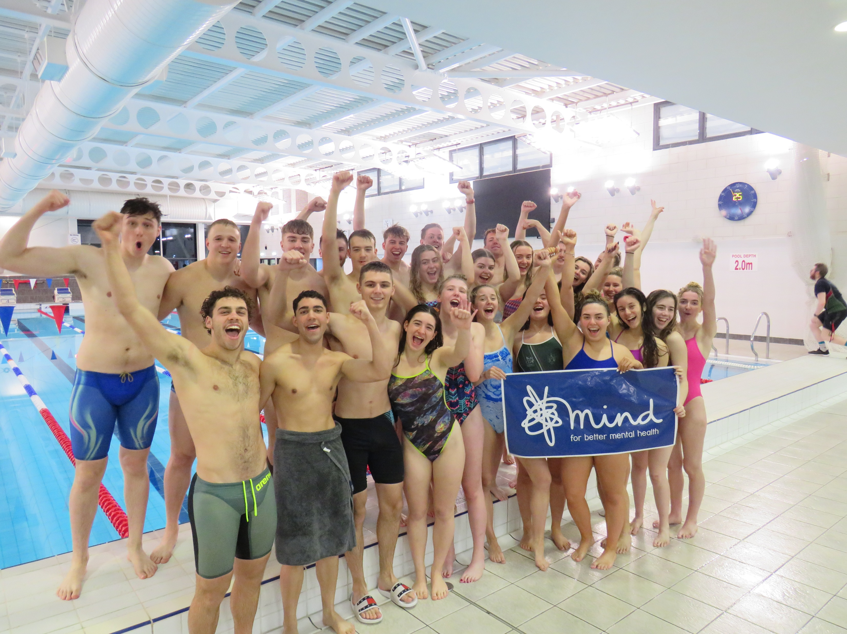
2. Club Overview and Our Goals
Club Overview
As mentioned, we are a competitive society with swimmers competing at high levels across the country including the British Swimming Championships, national events, the British Universities and College Sports competitions (BUCS) and the freshly established British University Swimming League (BUSL). We offer memberships to swimmers and water polo players to train in 1-8 sessions per week. We welcome swimmers and water polo players of all abilities, and our membership levels vary accordingly. As a result, we also have a thriving social scene that includes weekly socials after matches and our annual tour to Croatia in Easter.
Above all, we are a society that helps develop our members, providing them with skills and experiences that are far more useful than swimming itself. We have a strong sense of community and a large support network, with our welfare secretaries playing a significant role in our society. This culture upholds the core values behind university societies and promotes the true roots of our sports.

Slide 5
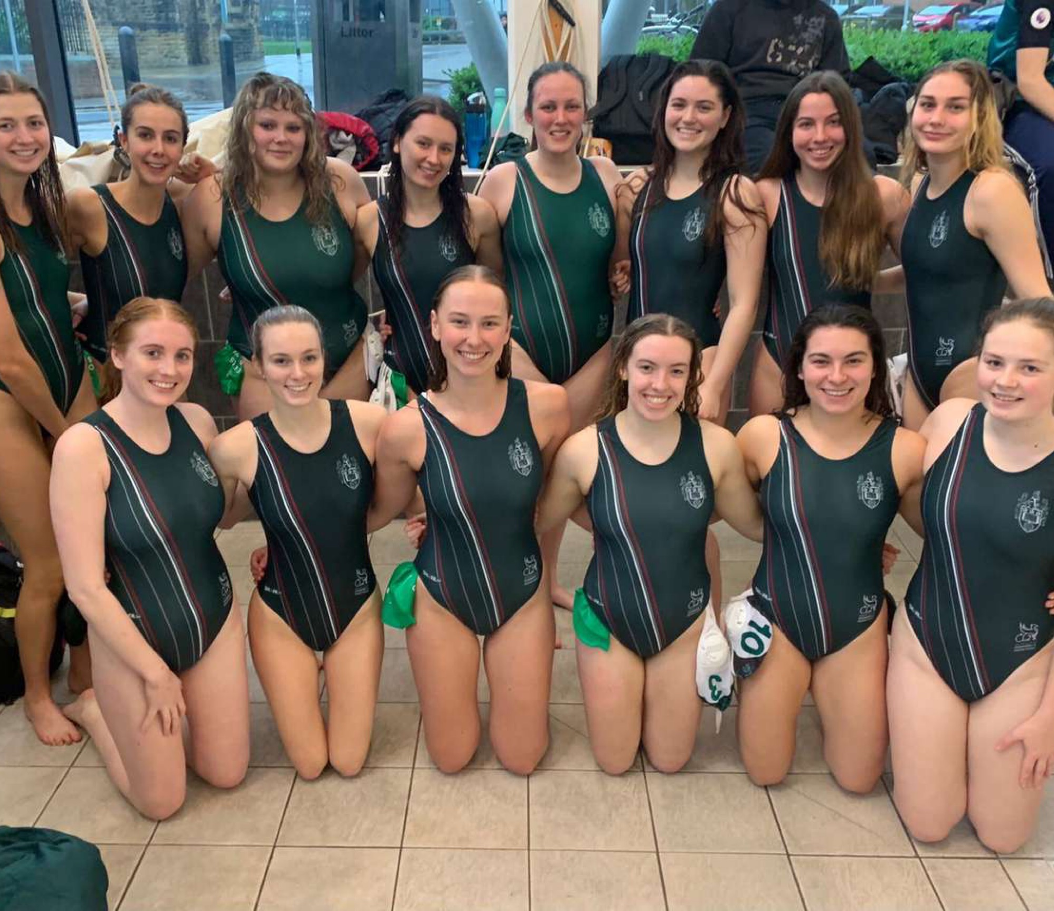
Our Goals
We hope with the help of your sponsorship, we can continue our momentum and continue to succeed in BUCS matches and Galas. With a committed and enthusiastic committee, we all believe that we can continue our high success rate both in and out the pool and flourish as a society. We hope that you can join us in achieving our goals and surpassing them.
We have an amazing level of charity engagement and pride ourselves on organising charity matches and galas to raise money for causes that are important to us as a society. Over the past year the society has taken part in an array of charity events, raising funds for the Movember Foundation, RNLI, Coppafeel, Alzheimer’s Research, Kidney Research and Mind. All together we have raised hundreds of pounds for these charities!
With your help, we can continue to raise money for these organisations whilst giving you a presence at these charitable events.

Slide 6
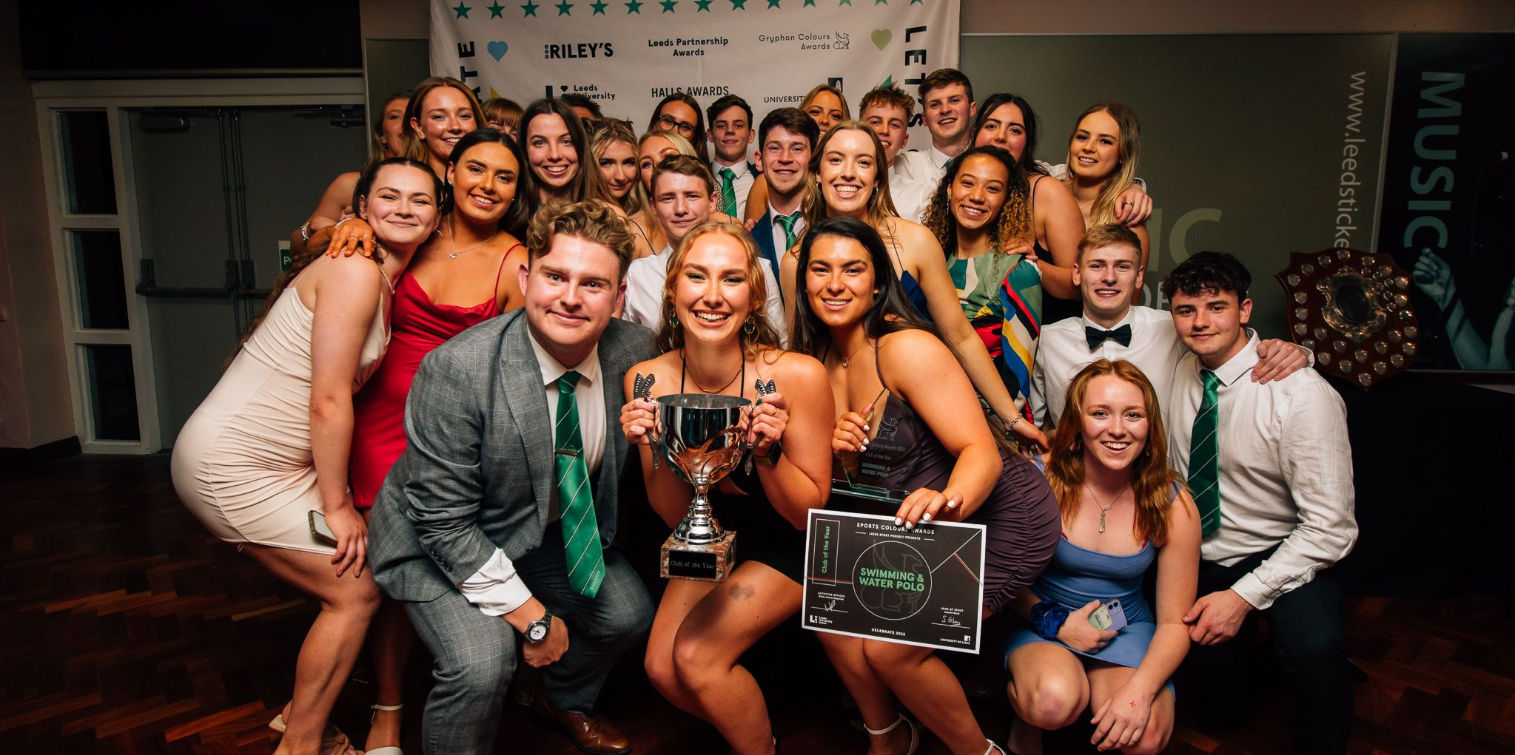
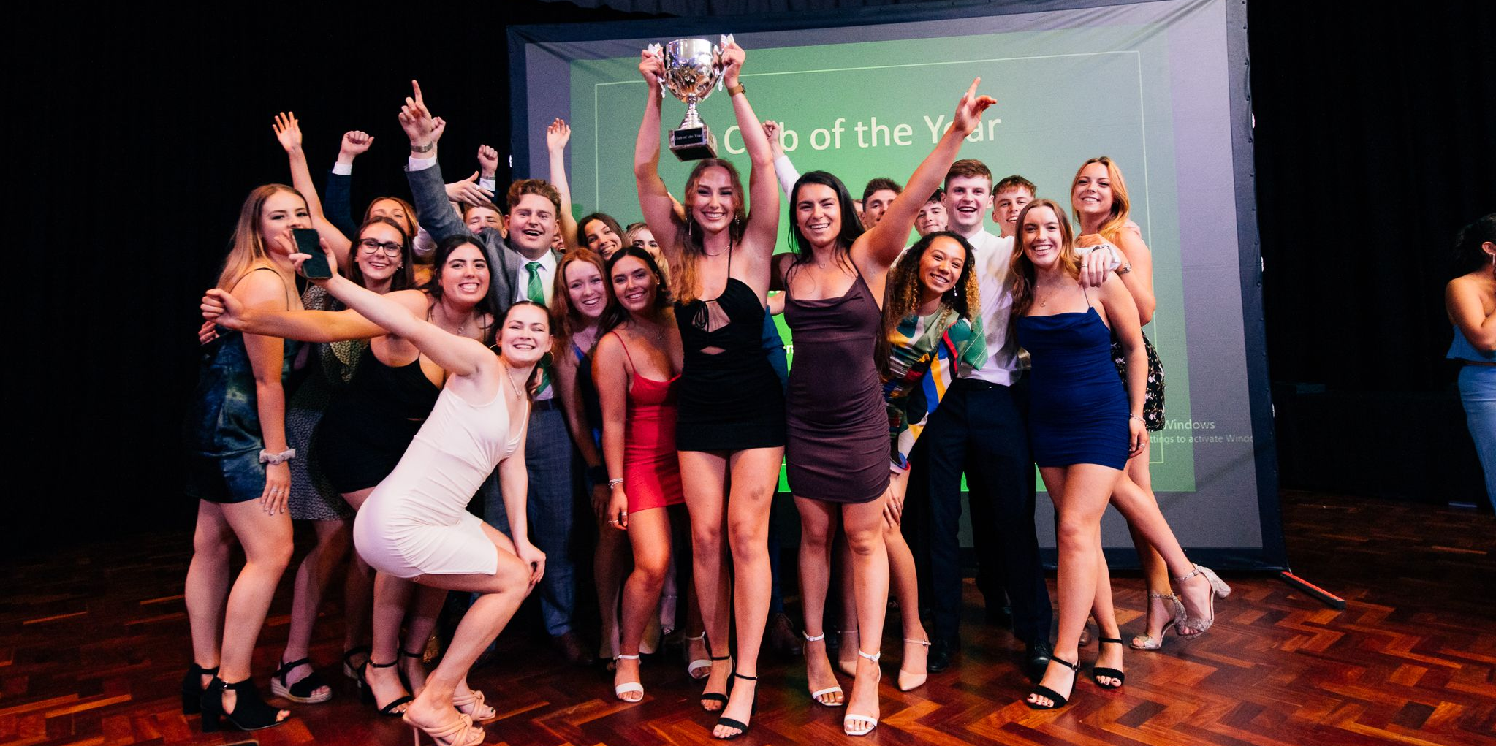
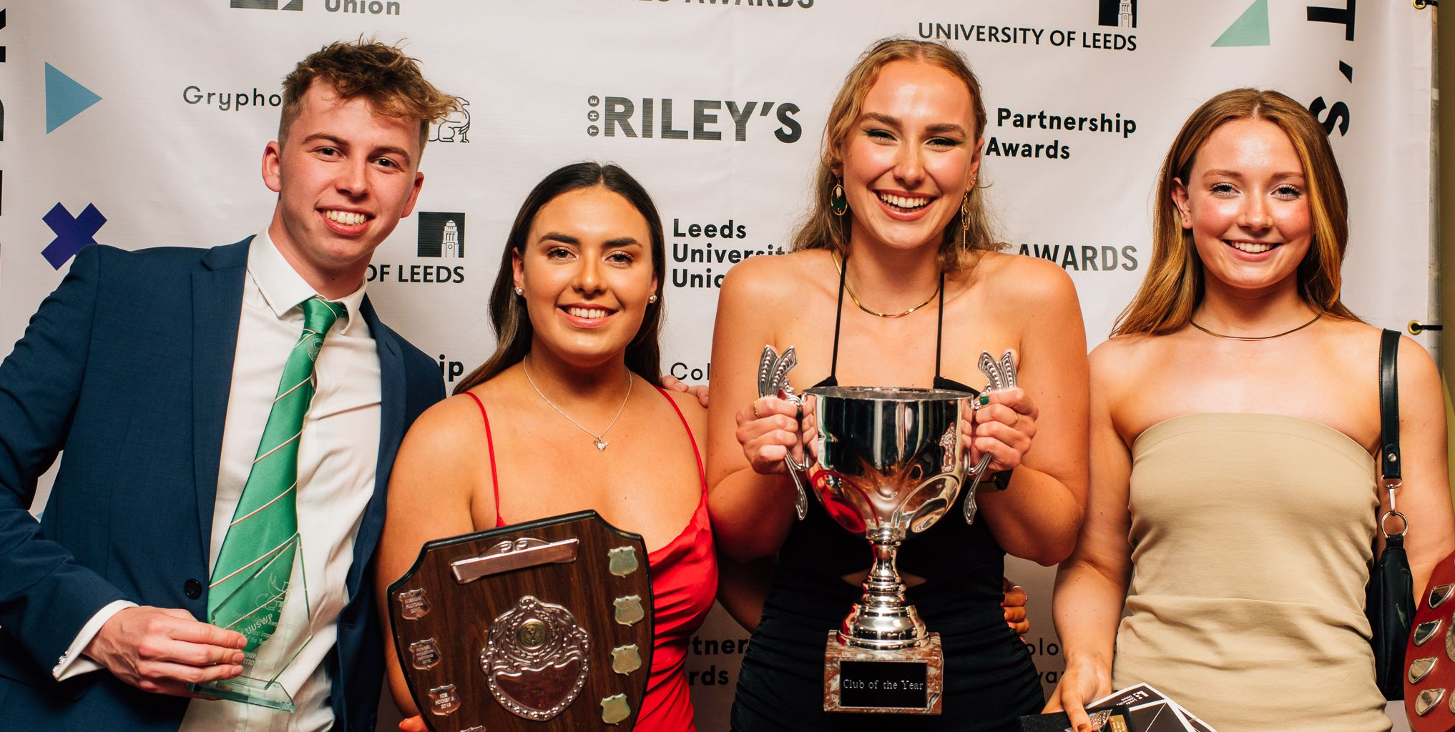
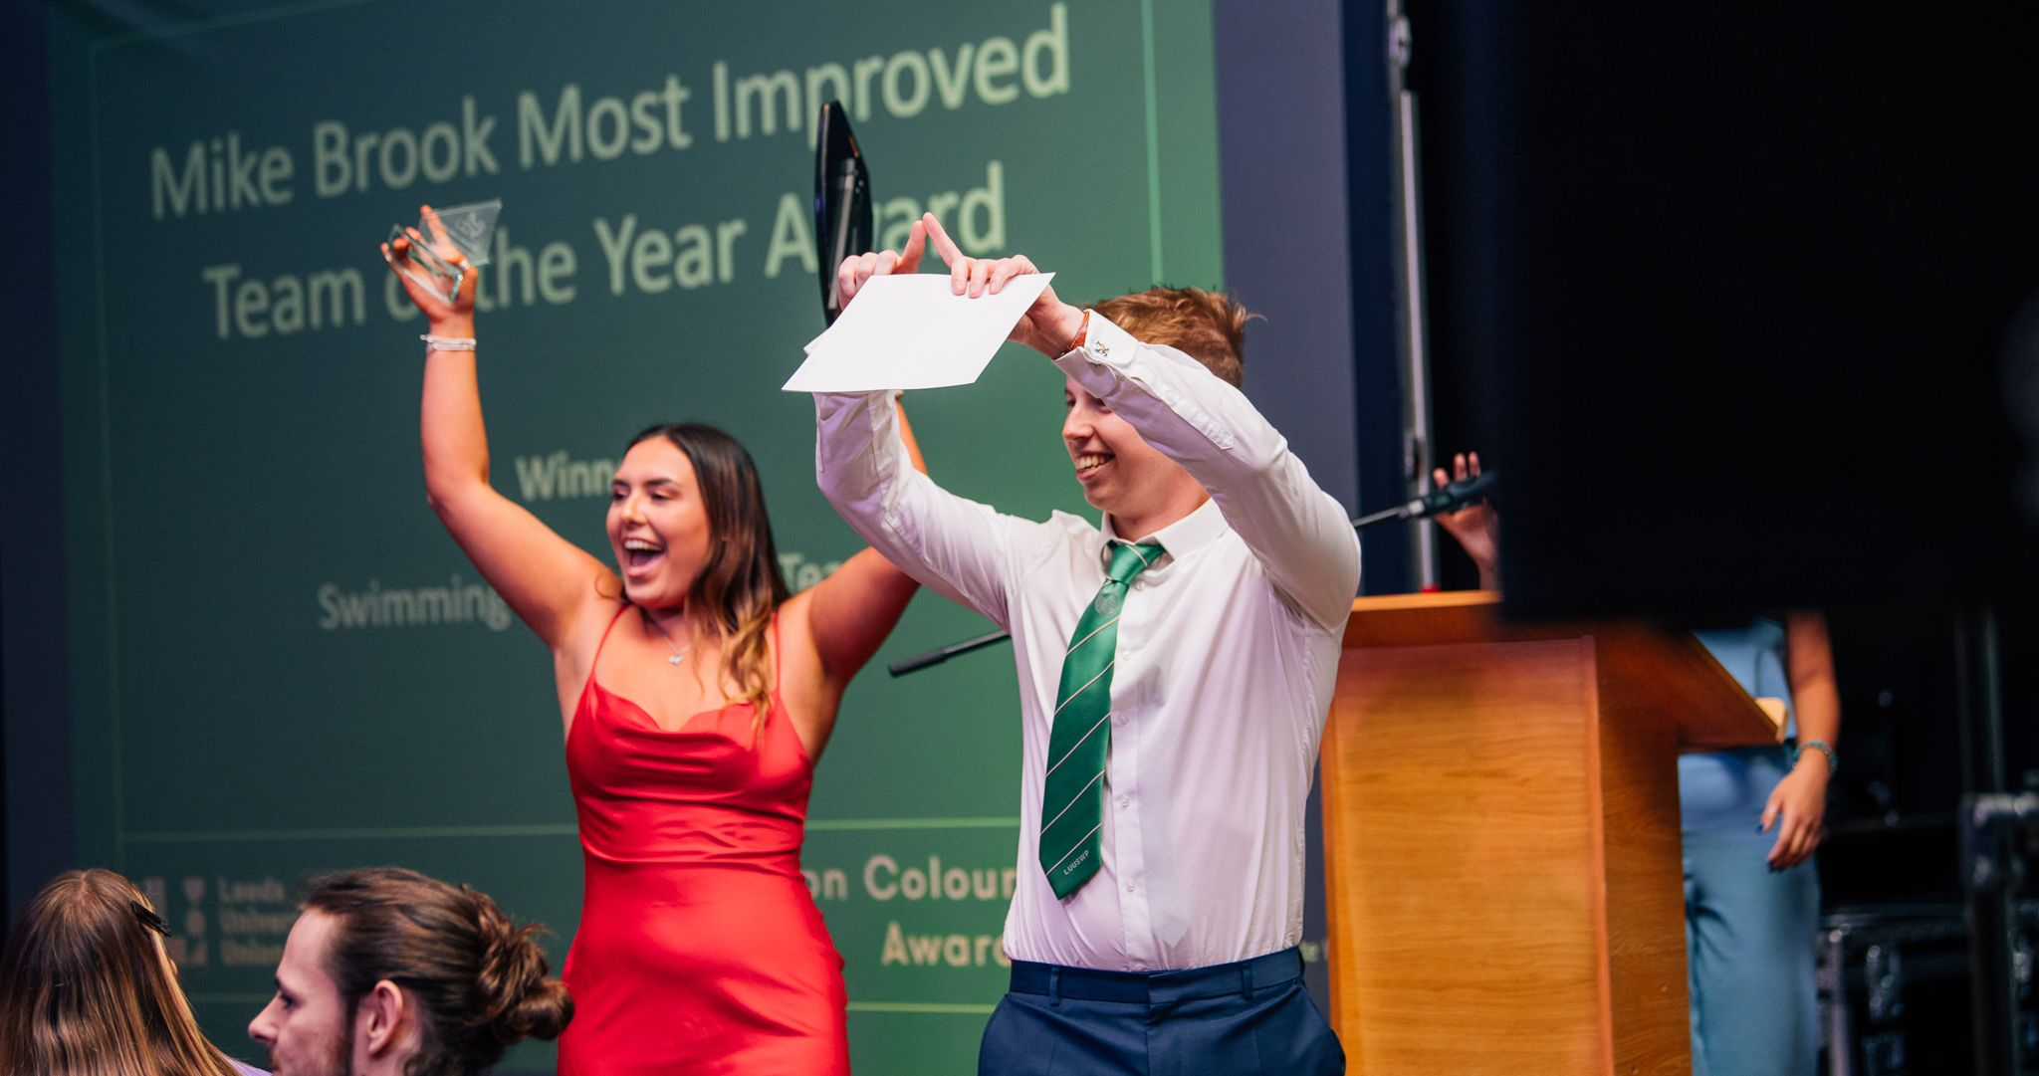
3. Our Achievements
Recently we were awarded ‘Leeds University Club of the Year’ out of all clubs and societies within Leeds University Union.
Alongside this award, our Swimming Competition team won ‘Most Improved Team’ as well as ‘Most Inclusive Club’.
Our Men’s Polo team were crowned National league cup champions this season and our Performance and Competition team managed to qualify for the BUSL A final .
This highlights how successful our club has been and with your help we can hope to carry this on.

Slide 7
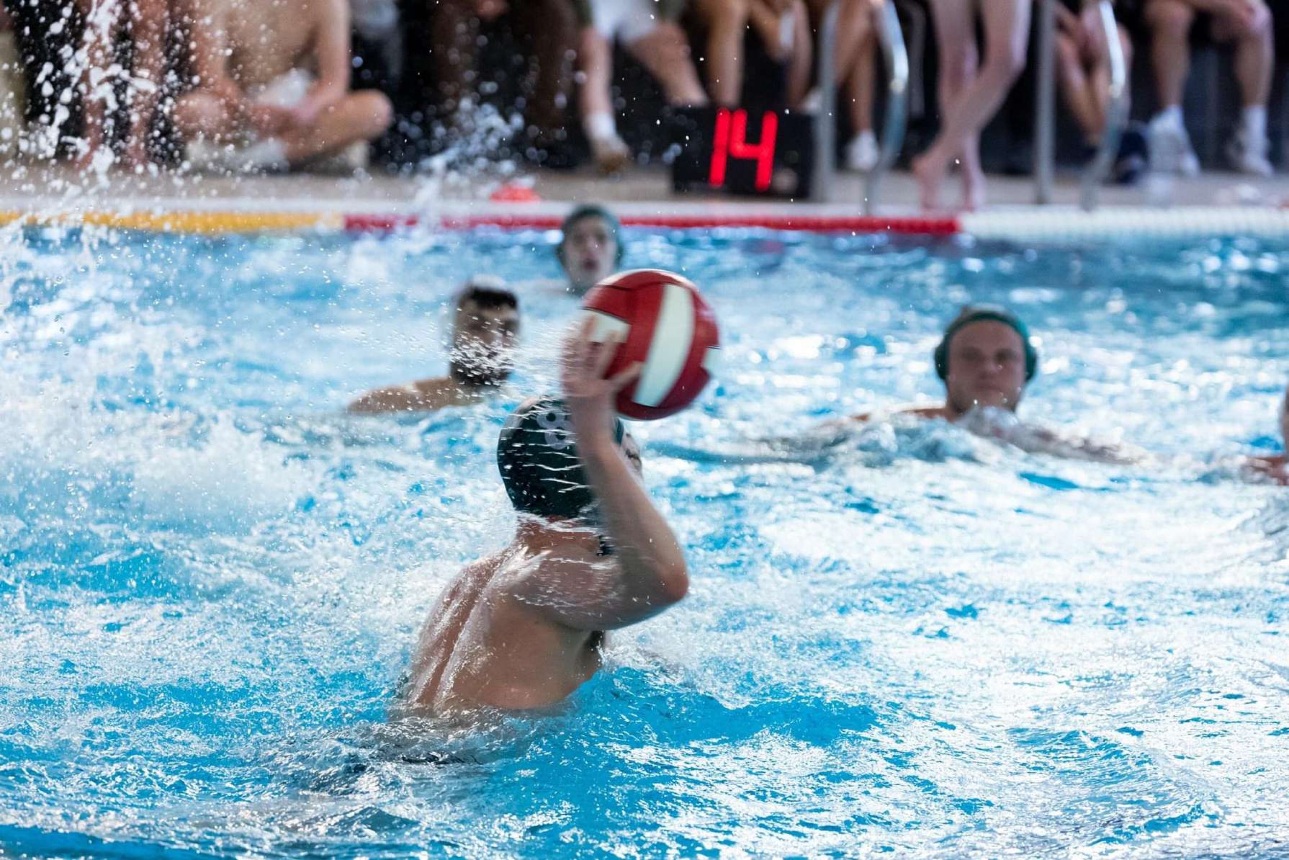
4. How will your sponsorship help you?
Sales | Naturally you will have members from our 200-strong society purchase your product or service, or at least will have gained interest in your company. So, if not for an immediate increase in sales from our members, your company will be word of mouth in the student community of Leeds, which will encourage an increase in sales by students who are both in and exterior to our society. You may wish to liaise with us as to how we could do more here. For instance, a discount coupon for each of our members would help drive your company’s sales.
Competitions and Events | Besides advertising your company around Leeds, in the form of the events and the connections that we hold, we can also offer vast exposure across the country with our many away days. Our water polo teams play at over 20 away games a year between them, seeing students from London to Scotland. Furthermore, our swimming team regularly competes at major venues, often drawing many of the general student population to watch and overall equating to an estimated exposure of over 300,000 students a year.
Social Media | We currently run a website and an Instagram, Facebook, TikTok and Twitter page, where we let our followers know about our up-and-coming events, recent achievements, and current club news with over 2,700 followers between them. There is the availability for you to post on these accounts through liaising with our media secretary. There will also be various opportunities for us to reach hundreds more students at non-sporting events, such as at freshers’ fair, our annual charity event, the AGM meeting and weekly socials.

Slide 8
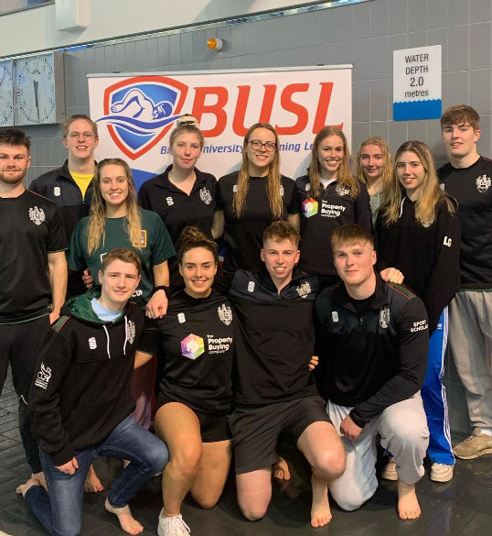
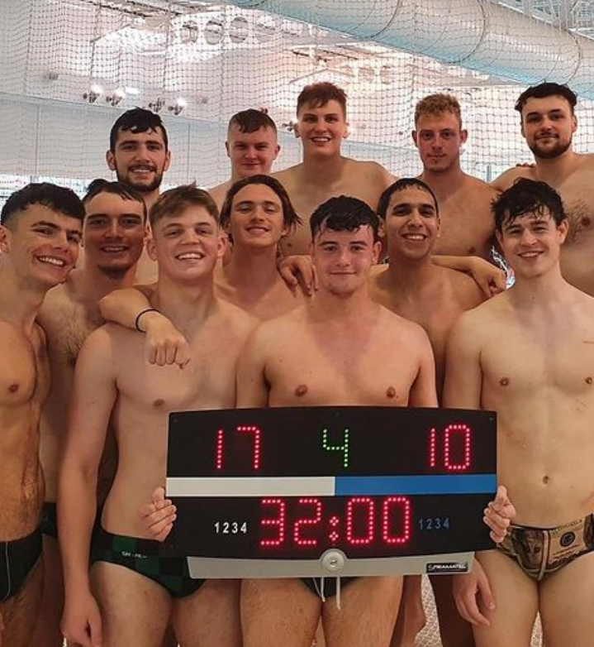
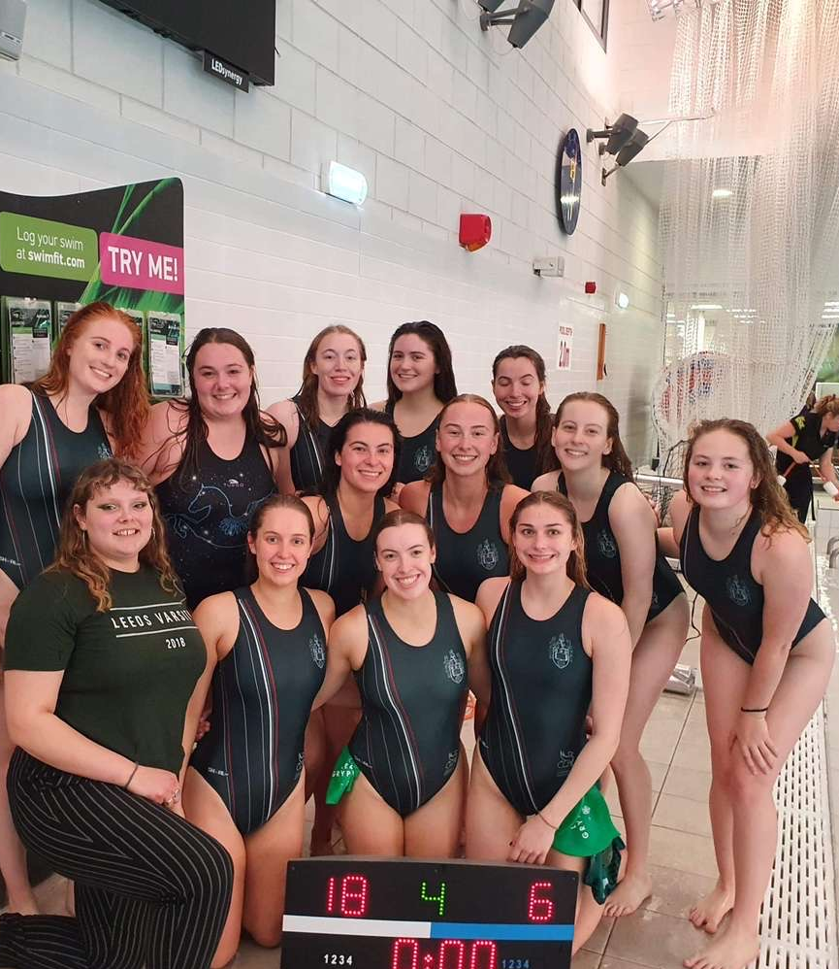
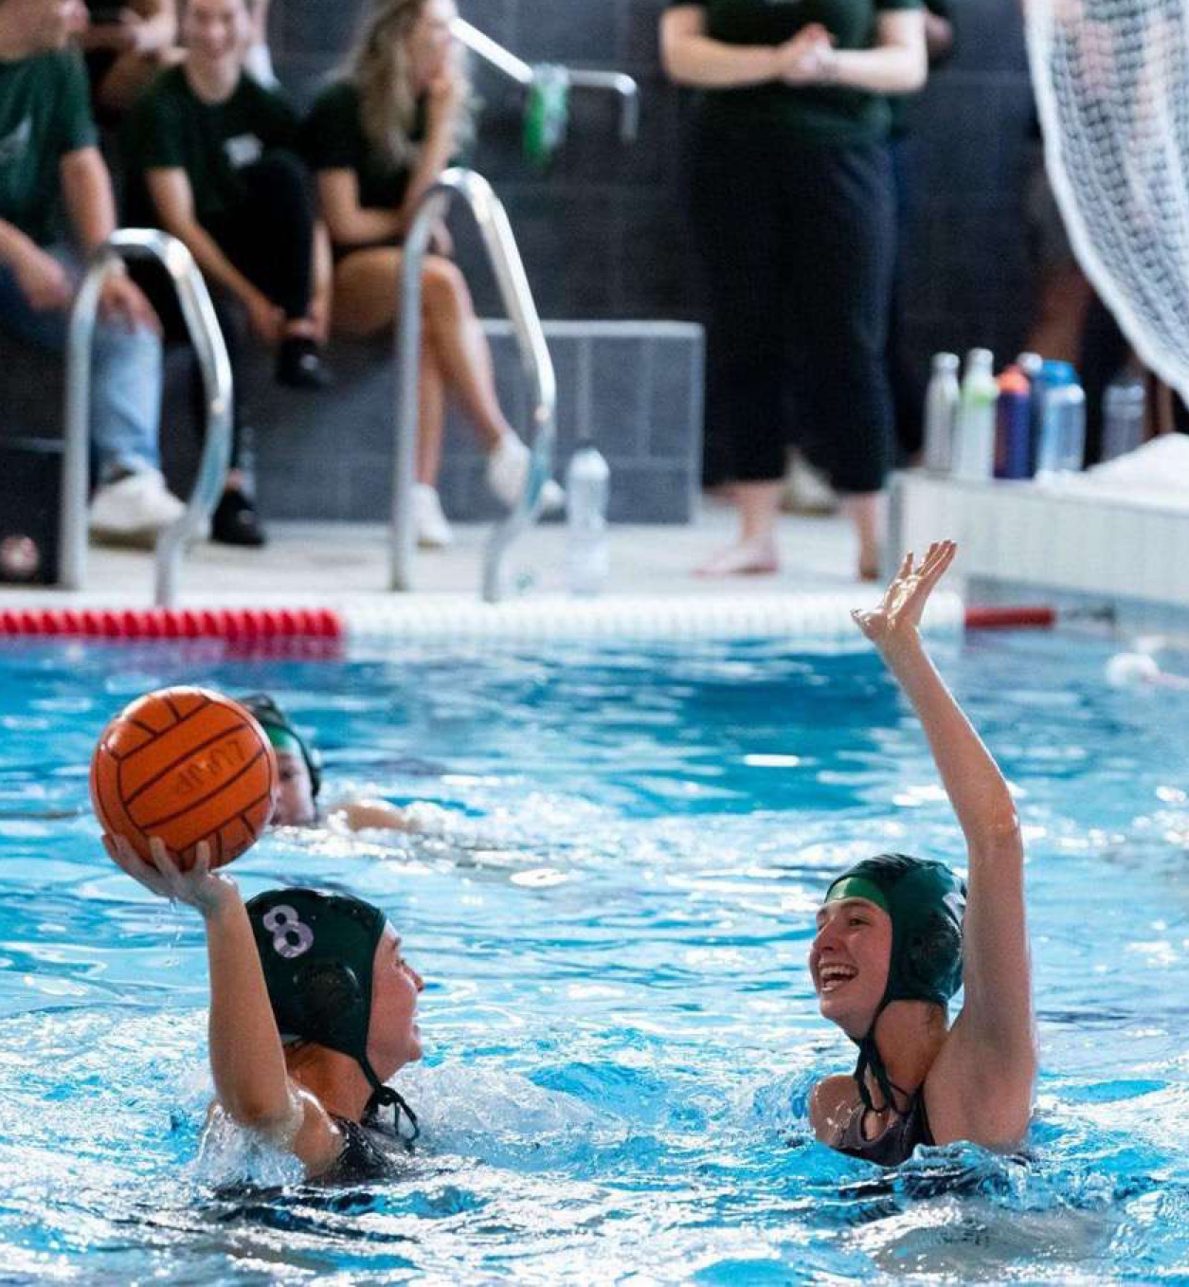
5. How will your sponsorship help us?
Throughout the year both swimming and water polo require pool time and transport in order to prepare for and attend matches or galas. The society’s costs for such hire, coaching and transport can amount to over £6000 per year. With your financial backing, we will be able to cover these with ease and provide our members with a platform to succeed and thrive.

Slide 9
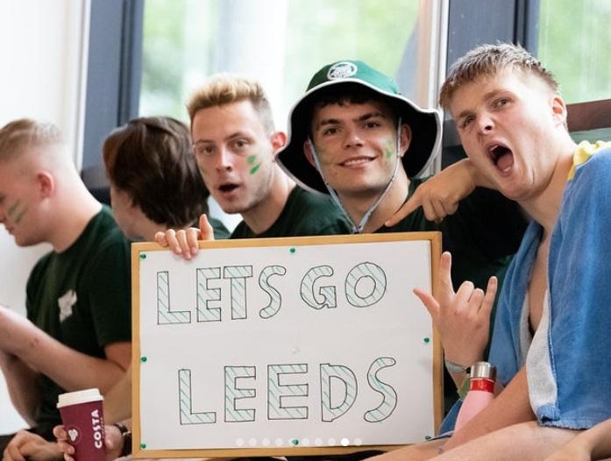
6. Sponsorship Packages
Bronze | £350
Logo displayed on social media platforms, including website.
Announcement post on Instagram and this post to be pinned to the top of our profile.
Silver | £550
Advertisement on any campus events you wish to undertake.
Monthly promotional post on social media platforms.
Opportunity to send targeted messages to all SWP members 3 times a year.
Logo displayed on social media platforms, including the website.
Announcement post on Instagram and this post to be pinned to the top of our profile.

Slide 10
6. Sponsorship Packages
Gold | £800
Promotion at Freshers Fair (personalised pull-up banner and promotional material). Potential reach is 10,000 students.
Promotion at BUCS matches and galas (personalised pull- up banner and potential promotion on team kit). The reach from such events can be up to 300,000 students.
Company Logo displayed on jumpers and kit, bought and worn by potentially 200 members worn throughout the year.
Company sponsored charity events (banners and customised kit can be used to promote).
Advertisement on social medias (we have over 2,700 followers across our platforms). This can include a monthly promotional post and your logo displayed on all our social media posts.
Company Logo displayed alongside LUUSWP logo which will be displayed on social medias and SWP website.
Opportunity to send targeted messages to all SWP members 6 times a year.

Slide 11
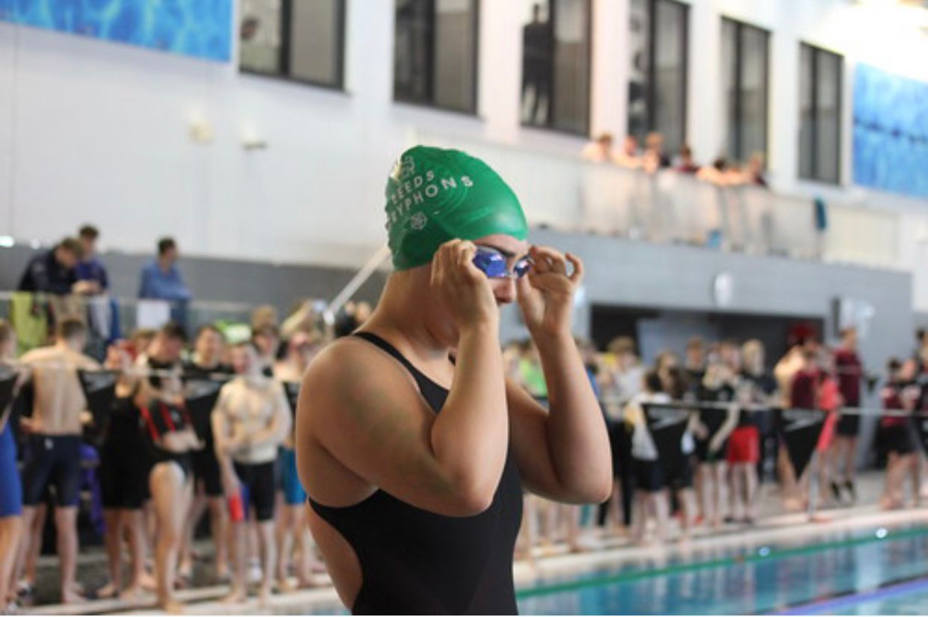
7. Contacts
Please feel free to contact us for further information or with any queries you may have.
Media and Sponsorship Secretary: Clair Green luuswpsec@gmail.com
President: Thomas Johnson luuswp@gmail.com
Our Website: luuswimpolo.com

